Slide 1


Thursday, 16th July 2026

Slide 2

Market Review

Slide 3
Local Macro Economic Indicators

Slide 4
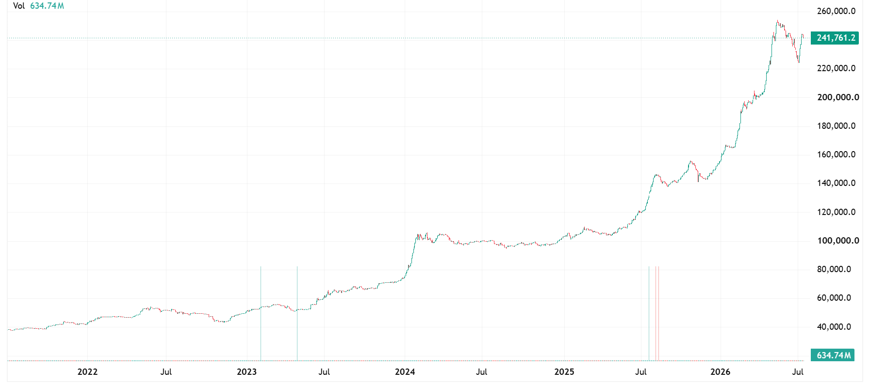
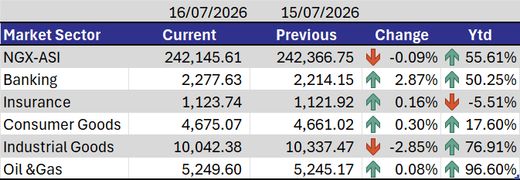
Equities Market
Driver
Gains in banking stocks driven by recapitalisation and earnings expectations were offset by profit-taking in industrial and consumer goods stocks, while higher Treasury bill yields tempered overall sentiment.
Outlook:
Market is expected to trade mixed, with banking stocks providing support, although profit-taking and attractive fixed-income yields may limit upside.
Top Gainers
Ticker | Price | Change
FIRSTHOLDCO | ₦87.25 | 9.96%
MCNICHOLS | ₦5.40 | 8.00%
UBA | ₦44.25 | 7.93%
VERITASKAP | ₦1.56 | 6.85%
JAIZBANK | ₦8.95 | 4.07%
Top Decliners
Ticker | Price | Change
EUNISELL | ₦189.00 | 10.00%
BUACEMENT | ₦275.60 | 9.99%
CAP | ₦142.45 | 9.61%
ROYALEX | ₦1.42 | 9.55%
GUINEAINS | ₦0.88 | 5.38%

Slide 5
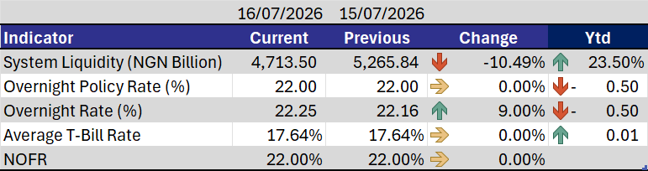
Money Market
Driver
Settlement from the ₦1.19tn NTB auction outweighed the ₦600.54bn FGN 2034 coupon inflow, reducing system liquidity to ₦4.71tn.
Outlook:
Funding rates are expected to ease in the near term, barring any significant market shocks.

Slide 6
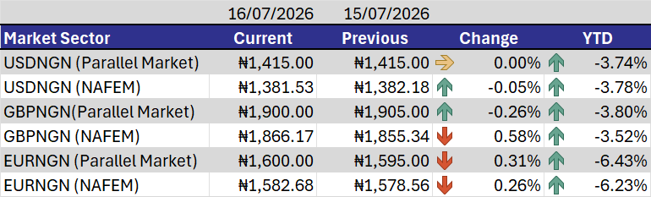
FX Market
Driver
The naira remained broadly stable as improved FX liquidity and sustained CBN interventions continued to support the market, while the pound and euro recorded marginal gains on stronger demand.
Outlook:
The naira is expected to trade within a stable range, supported by improved FX supply, although demand for foreign currencies may keep the pound and euro slightly elevated.

Slide 7
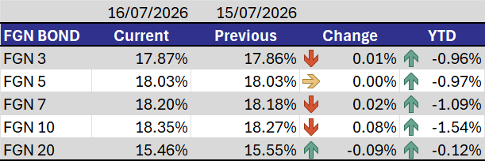
Bonds Market
Driver
Investors shifted their focus to the post-NTB PMA, resulting in muted trading activity, with mild profit-taking concentrated at the long end.
Outlook:
We anticipate sustained investor interest in the domestic market over the near term.

Slide 8
Euro Bonds Market
Driver
Supported by strong global risk appetite, expectations of a more accommodative U.S. Federal Reserve, stable U.S. Treasury yields, and firm crude oil prices, which continued to underpin Nigeria's external outlook.
Outlook:
Eurobond yields are expected to remain range-bound, with investor focus on U.S. monetary policy, geopolitical developments, and global risk sentiment.

Slide 9
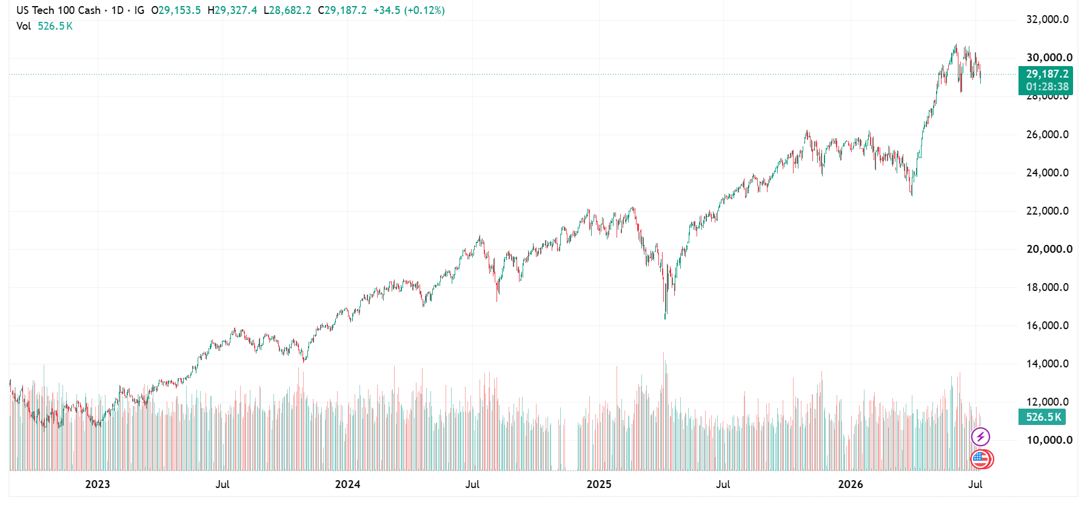
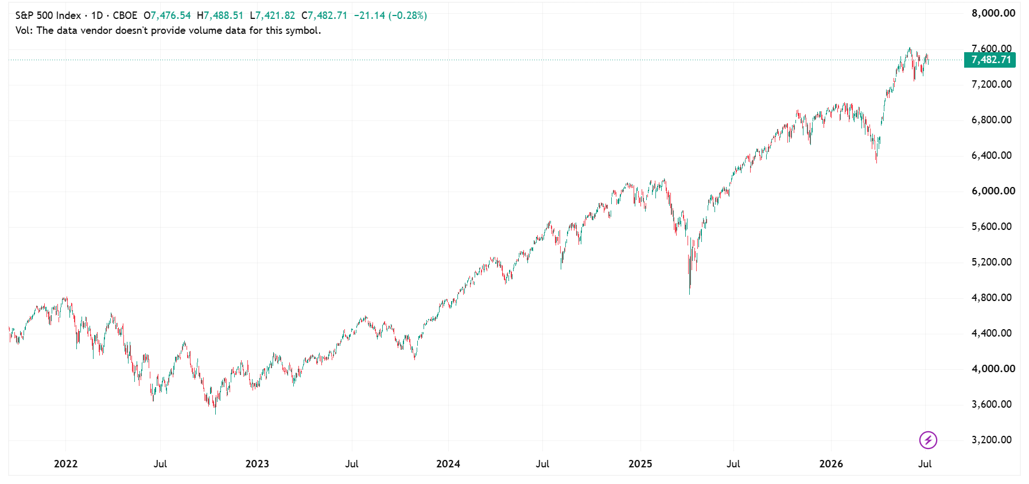
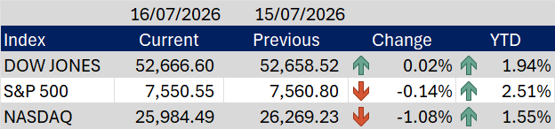
Global Equities Market
Driver
Mixed corporate earnings and profit-taking in technology stocks outweighed optimism over easing Fed rate expectations, resulting in mixed performance across major U.S. indices.
Outlook:
Global equities are expected to remain range-bound as investors balance earnings releases against interest rate expectations and geopolitical developments.

Slide 10
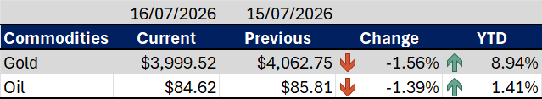
Commodities Market
Driver
Gold and oil prices declined as easing geopolitical risk sentiment and a stronger U.S. dollar reduced safe-haven demand and weighed on commodity prices.
Outlook:
Commodity prices are expected to remain volatile, with movements driven by geopolitical developments, U.S. economic data, and the outlook for Federal Reserve policy.

